Slide 2
What is THE GAME?
Greenville is a pretend island
8 groups
Two students are “The Fates” – they run the game
There are 8 challenges that you have to solve

Slide 3
Each group has resources that can help solve problems
You have to talk to each other to figure out how to combine your things to solve the problems

Slide 4
HOW IS IT PLAYED?
Teams look at the problems to be solved and the resources people have to solve them and try and come up with solutions
Every problem can be solved by an idea that combines 2-4 things together

Slide 5
Skills:
Teamwork
Problem solving

Slide 6
EXAMPLE

Slide 7
NUCLEAR MELTDOWN
What is it?
Some power plants make electricity from nuclear energy. If the power plant is damaged, some of the nuclear waste can leak out.
What causes it?
Lots of different things. Sometimes there is an accident in the power plant. There could be an earthquake where the nuclear power plant is.
How is it affecting Greenville?
There has been an accident at the nuclear power plant and it has gone into “meltdown”, leaking nuclear waste.

Slide 8
GROUPS

Slide 9
THE FATES

Slide 10
The fates
The Fates run the game
The Fates will tell you if your solution solves the problem
The Fates write down the solutions on the solutions whiteboard

Slide 11
MINERS

Slide 13
MINERS
Mining is digging things out of the ground. Miners can dig oil, gas, coal or diamonds. In Greenville, the miners dig metal out of the ground.
Resources: two lots of metal
For building things that need to be extra strong

Slide 16
INVESTORS

Slide 18
INVESTORS
Investors put money into ideas to make a profit when that idea is successful. In Greenville, investors have lots of money to spend on solutions to the challenges.
Resources: four lots of money
For solutions that cost a lot.

Slide 21
SCIENTISTS

Slide 23
SCIENTISTS
A scientist tries to understand how our world, or other things, work. In Greenville, scientists invent things that solve problems
Resources: two inventions
to solve a problem, but it must be actually possible (you can’t invent a time machine)

Slide 26
GOVERNMENT

Slide 28
GOVERNMENT
The government is a group of people with the power to make laws
Resources: four laws
To make Greenville residents change how they behave.

Slide 31
CITIZENS

Slide 33
CITIZENS
Citizens are people that live in a country. In Greenville, the citizens are the people that make up most of the population
Resources: three workers
For solutions that need lots of hard work

Slide 36
PARK RANGERS

Slide 38
PARK RANGERS
Park rangers are people who help run national parks. In Greenville, they run the large national park, and look after the animals there
Resources: two creatures
For any solution that requires some kind of creature to solve it

Slide 41
FARMERS

Slide 43
FARMERS
A farmer is a person who grows crops and raises animals to be used as food. In Greenville, the farmer owns the farmland and the bushland
Resources: two pieces of land
For any challenge that needs land to solve it

Slide 46
BUILDERS

Slide 48
BUILDERS
A builder is a person who constructs something by putting things together
Resources: three buildings
for building something big

Slide 51
LET’S CHOOSE TEAMS!

Slide 52
THE CHALLENGES

Slide 53
AIR POLLUTION

Slide 56
AIR POLLUTION
What is it?
When air is made dirty by smoke and harmful gases
What causes it?
Smoke from cars
Power plants that burn coal to make electricity

Slide 57
AIR POLLUTION
How is it affecting Greenville?
People in Greenville are getting sick from breathing in the air pollution.

Slide 59
ENDANGERED SNOW TIGER

Slide 62
ENDANGERED SNOW TIGER
What is it?
When an animal is endangered, it means that there are not many of them left. If all the animals of a species die, it is called extinction
What causes it?
People hunt the tigers
People cut down the forests where they live, so they have nowhere to live

Slide 63
ENDANGERED SNOW TIGER
How is it affecting Greenville?
There is only one snow tiger left!

Slide 65
Poor soil

Slide 68
POOR SOIL
What is it?
Poor soil is when the soil doesn’t have enough nutrients in it for plants to grow.
What causes it?
Overusing the same land again and again without letting it rest by not planting anything there
The soil blows away because there aren’t enough trees planted around it. The roots of trees help keep the soil stuck together

Slide 69
POOR SOIL
How is it affecting Greenville?
Vegetables and fruit aren’t growing very well.

Slide 71
DEFORESTATION

Slide 74
DEFORESTATION
What is it?
Deforestation is when forests are destroyed by cutting and are not replanted
What causes it?
Trees being cut down to use their wood for building or to make paper
Trees being cut down to use the land for other things like cities and farms

Slide 75
DEFORESTATION
How is it affecting Greenville?
Greenville City is growing quickly and forests have been cut down to allow it to grow bigger. Sometimes people cut down the trees to use the wood to make things or to burn as firewood.

Slide 77
SEA LEVEL RISE

Slide 80
SEA LEVEL RISE
What is it?
Sea level rise is when there is more water in the sea. This makes the level of the sea at the coast higher
What causes it?
Climate change melts ice on land which then goes into the sea

Slide 81
SEA LEVEL RISE
How is it affecting Greenville?
On Greenville, the sea level has risen at the coast of Greenville City. It is making the city get flooded more and more often

Slide 83
OCEAN RUBBISH

Slide 86
OCEAN RUBBISH
What is it?
Rubbish gets into the ocean either on purpose or by accident. Lots of it is plastic which stays around for thousands of years
What causes it?
Littering: rain can make this rubbish flow into drains and out to sea
Some people and companies also dump rubbish illegally in the ocean

Slide 87
OCEAN RUBBISH
How is it affecting Greenville?
Rubbish in the ocean is killing marine wildlife

Slide 88
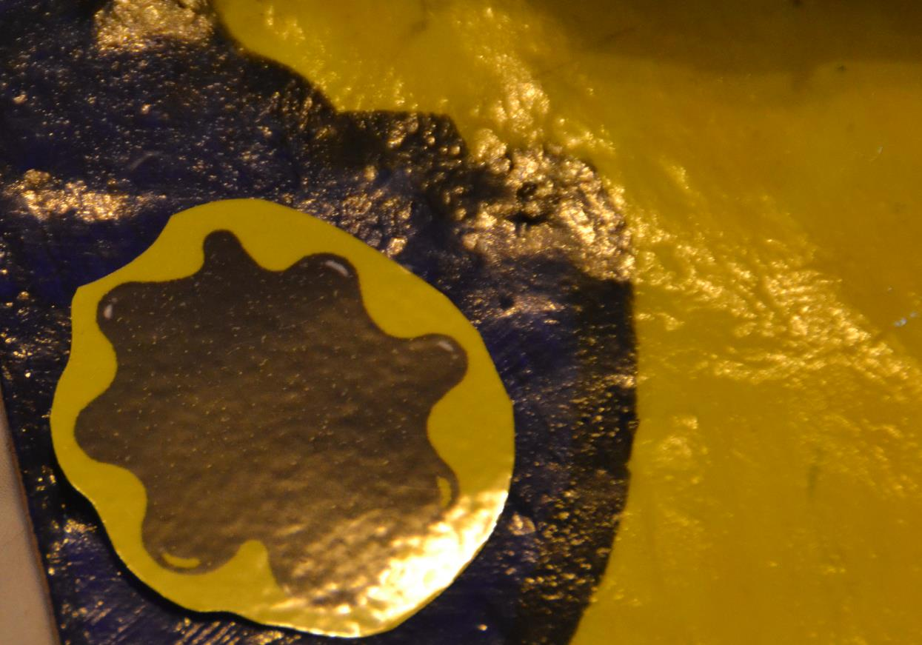

Slide 89
INSECT INVASION

Slide 92
INSECT INVASION
What is it?
An insect that has come from a different place. There often isn’t anything that attacks these insects in the new place, so it takes over the new area easily.
What causes it?
Somehow an insect gets to another place
Not having anything that attacks it in the new place

Slide 93
INSECT INVASION
How is it affecting Greenville?
Locusts have shown up and are causing lots of damage. They are eating the farmer’s crops, damaging the forests and annoying people across the island.

Slide 94
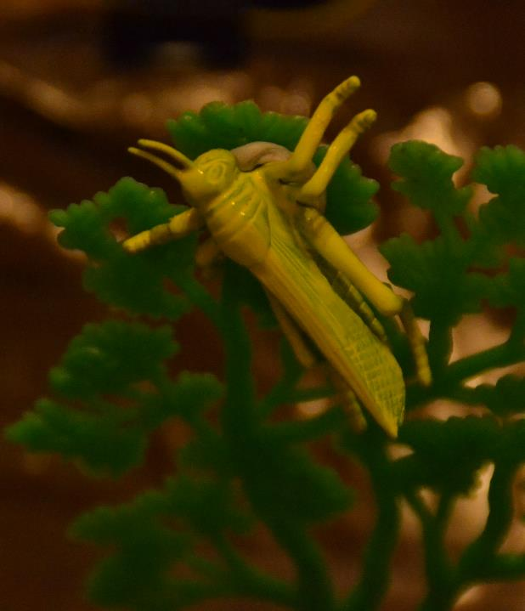
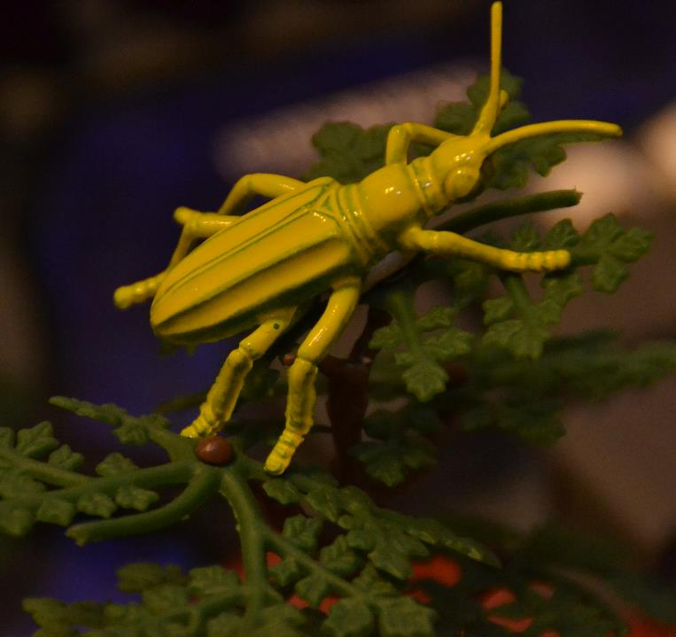

Slide 95
DROUGHT

Slide 98
DROUGHT
What is it?
Drought is a really long time with very little rain. Plants need water to grow, and animals and humans need water to drink.
What causes it?
Climate change changes weather patterns, making it stop raining in some places

Slide 99
DROUGHT
How is it affecting Greenville?
There has been a drought in Greenville for the last few years. Deforestation has made the drought worse, because big forests actually make it rain more.

Slide 101
SOLVING PROBLEMS
Every problem needs:
Either money or a new law
2-4 resources to solve it
EVERY resource must be used

Slide 102
SOLVING PROBLEMS
Think up ideas
Think what resources they will need
Speak to the leader of the group that owns that resource and ask them if you can use it
Get Fate to make an announcement

Slide 103
SOLVING PROBLEMS
5. Explain your solution
6. Change the board
Put the resources in the box
Remove the challenge piece
Add the piece that shows your solution
7. Fate writes up solution on the board

